Slide 1
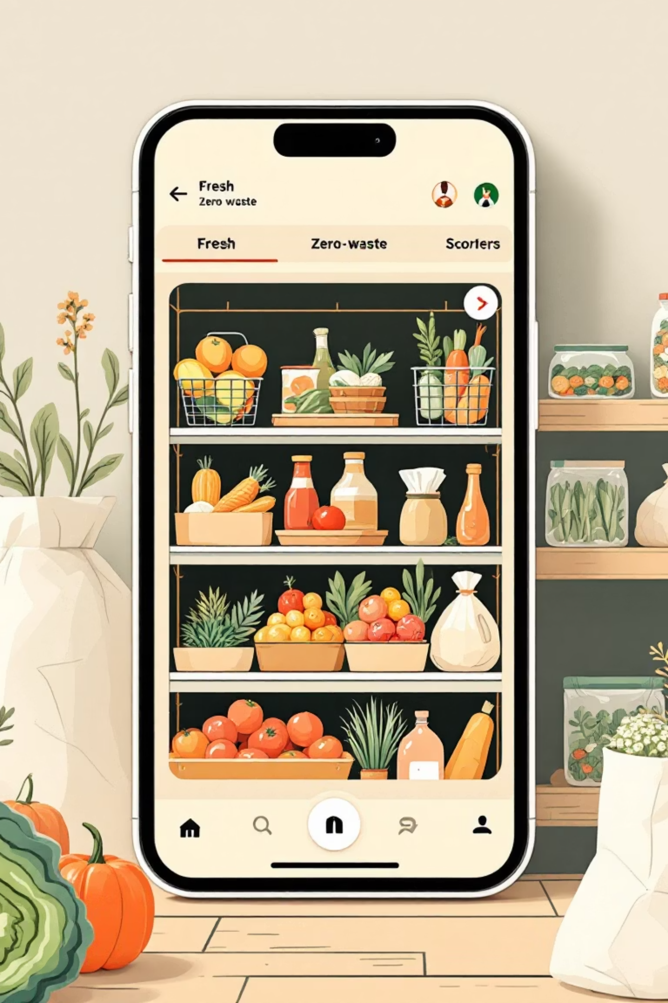
Smart Grocery: The App to End Food Waste

Slide 2
Overview:
This presentation outlines the product strategy,design process,and core features for 'Smart Grocery',a mobile application focused on drastically redusing household food waste. We aim to create a clear, practical,and highly enganging user experience that drives behaviour change and sustainablity.

Slide 3



Defining the Problem & Solution
The Problem
Over 1.3 billion tonnes of food are wasted globally each year. For users, this means financial loss, wasted resources, and contributing to climate change. Current solutions are often inconvenient or incomplete.
The Solution
Smart Grocery digitises the entire food management process—from purchase planning to consumption tracking—to ensure users only buy what they need and use what they have before it expires.
Major Goals for Smart Grocery
Promote Sustainability
Simplify Inventory Management
Establish the app as a leading tool for environmentally conscious consumers to reduce their carbon footprint.
Maximise Cost Savings
Help users save an estimated 15-20% on weekly grocery spending by eliminating impulse buys and waste.
Provide effortless tracking of pantry and fridge contents, including automatic expiry alerts.

Slide 4



Target Audience & User Profile
Our primary audience comprises individuals and families actively seeking practical ways to save money and live more sustainably, but who are pressed for time.
User Group Focus
Budget-conscious consumers, busy professionals/parents, and early adopters of smart home technology who value efficiency.
Target Age Range
25–45 years old. This demographic is tech-savvy, responsible for household budgeting, and environmentally aware.
Core Design Philosophy
The entire design process prioritises rapid prototyping, user testing, and iteration, ensuring the final product solves real-world pain points effectively and intuitively.

Slide 5


Phase I: Empathise & Research
A deep understanding of user behaviour is crucial. We must empathise with their daily struggles and motivations regarding food shopping and management.
Product Manager
UX Designer
Key Stakeholder
Focuses on market fit, feature prioritisation, and aligning the product vision with business KPIs.
Concentrates on information architecture, interaction design, and creating delightful user flows.
Provides strategic oversight, ensures adequate resource allocation, and validates market assumptions.
Qualitative Research: Sample Interview Questions
What is the most frustrating part of planning your weekly groceries?
How do you currently track food expiration dates, and how often do you miss them?
In a typical week, how much money do you estimate you waste on spoiled food?
Describe the last time you realised you had bought an ingredient you already owned.
What features, if any, have you used in other inventory/shopping apps?
How willing are you to scan items into a digital inventory?
Do you prefer recipe recommendations based on ingredients you need to use up or ingredients you need to buy?
What external factors (e.g., store sales, family requests) disrupt your shopping routine?
How important is it for you that the app integrates with smart home devices?
What would motivate you most to use a food waste reduction app daily?

Slide 6
Competitor Analysis:
Target fit — How well the app’s core audience matches yours (households, families, students, zero-waste users).
Core features — Inventory + expiry tracking, shopping lists, meal planner, reminders, barcode/receipt scan. (Does it do the bread-and-butter things?)
Waste-reduction impact — Features that actually prevent waste: smart suggestions, portion planning, expiry alerts, resale/donation flows, compost guidance.
UX & onboarding — Speed of setup, ease of adding items, clarity of alerts, friction in daily use. High UX = higher retention.
Business model & monetization — Free vs freemium vs paid, ads, partner grocery revenue — affects user trust and scaling.
Market traction & partnerships — Users, ratings, retailer partnerships, press — indicates viability and barriers to entry.
Example (3 competitor archetypes — fill with actual apps later)
Competitor archetype
Target fit
Core features
Waste impact
UX
Integrations
Biz model
Traction
Raw score
Food-waste specialist (e.g., focused app)
5
4
5
3
2
3
3
25
Grocery/Delivery platform
4
3
3
4
5
4
5
28
Recipe/inventory app
3
4
3
4
3
2
2
21
(Raw score = sum of 7 params — higher is stronger. You can apply weights; e.g., give Waste impact weight×2 if that’s the most important.)

Slide 7
Feature Analysis:
Here’s a 5-point feature analysis for a Smart Grocery Companion App for Food Waste Reduction — simple and clear:
1. Smart Inventory Tracking
Automatically tracks groceries purchased (via receipts or manual input).
Sends expiry alerts and usage reminders.
2. Expiry Date Notifications
Scans barcodes or allows manual entry of expiry dates.
Sends push alerts for items nearing expiration.
3. Recipe Suggestions from Leftovers
Recommends recipes based on available and soon-to-expire items.
Encourages creative meal planning and reduces waste.
4. Smart Shopping List
Auto-generates shopping lists based on stock and meal plans.
Avoids overbuying by highlighting already-owned items.
5. Waste Tracking & Insights
Tracks discarded food items and reasons (expired, unused, etc.).
Provides analytics on waste reduction over time.

Slide 8

Strategic Analysis: SWOT
A balanced view of the project's internal and external factors.
Strengths
Weaknesses
Unique focus on integrated waste reduction analytics.
Requires initial user commitment for inventory input (a friction point).
High potential for user cost savings as a key motivator.
Reliance on accurate, up-to-date food database information.
Intuitive interface designs (planned).
Initial lack of brand recognition.
Opportunities
Threats
Growing consumer interest in sustainability and budgeting.
Established incumbents adding similar features.
Partnerships with major grocery retailers and smart device manufacturers.
Privacy concerns regarding shopping data.
Expansion into bulk/restaurant inventory management.
Economic downturn reducing consumer spending on new apps.

Slide 9

User Persona:
Ellie Thompson, 34
Marketing Manager. Lives in London with her partner. Highly organised at work but often chaotic at home. Attempts to be highly sustainable but struggles to maintain routines due to a busy schedule.
Goals & Motivations
Reduce weekly food spend by at least £20.
Feel less guilty about throwing away wilted vegetables.
Streamline meal planning so it takes less than 20 minutes.
Contribute meaningfully to household sustainability goals.

Slide 10
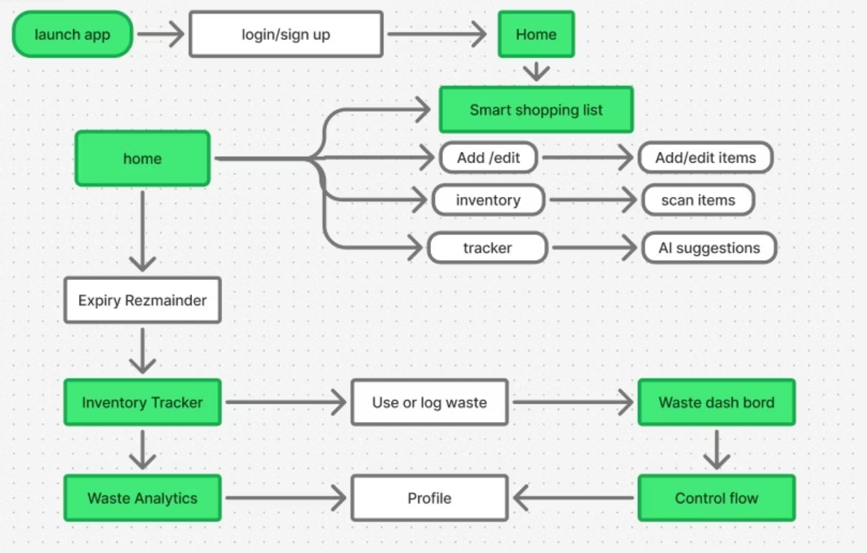
User Flow:

Slide 11
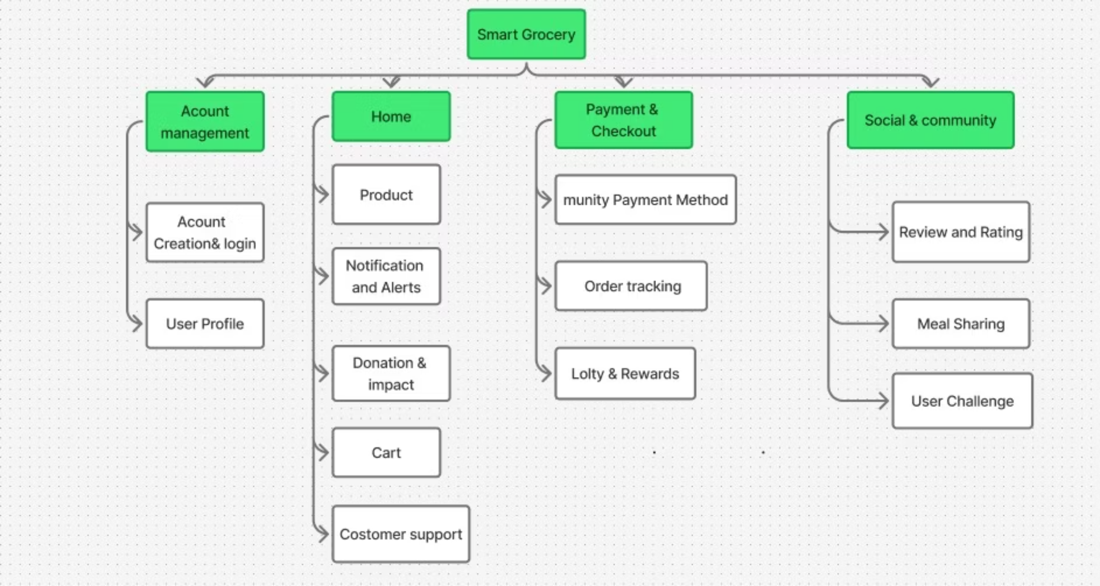
Information Architecture:

Slide 12
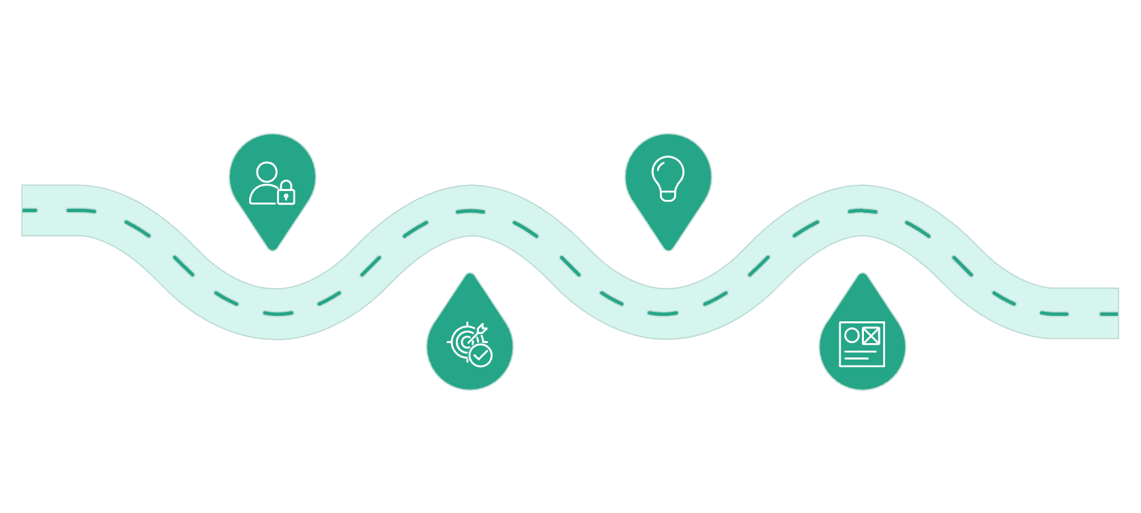

Design Process:
Empathize
Ideate
Understand users’ grocery waste problems
Brainstorm smart reminder and tracking ideas
Define
Prototype
Clarify problem and personas
Build mockups for dashboard and alerts
💭 Empathize Phase
🔑 Key Role: Research & Understanding
To understand the problems users face when managing their kitchen, I conducted both qualitative and quantitative research. I used interviews, live observation, and surveys to collect behavioral data and pain points.
Participants:
5 users (aged 20–40)
Mix of single individuals, couples, and small families
All tech-savvy and responsible for their groceries
Key Takeaways:
100% forget expiry dates often.
Most used no system or basic reminders (sticky notes, mental notes).
They wanted something simple, fast, and not annoying.
Recipe suggestions were a highly desired feature.
👀 Observing
Through contextual inquiries, I observed:
Cooking sessions in user kitchens.
Grocery shopping behavior.
Findings:
Users overbought the same ingredients (especially perishable ones).
Many didn’t check their pantry before going shopping.
Food items were lost or expired deep in shelves or fridges.
📊 Analyzing
I created affinity diagrams and grouped insights into:
Functional gaps
Motivational drivers
Common frustrations
Wishlist features
Patterns clearly showed that users needed:
A central place to track everything
Visual expiry reminders
Meal suggestions to use items before expiry

Slide 13












Empathy Mapping :
We use the empathy map to synthesise our qualitative data and truly understand Ellie's psychological landscape.
Says
Does
“I feel so wasteful throwing food away.”
Scrolls through online shopping sites repeatedly.
“Meal planning is a nightmare after a long day.”
Puts new groceries on top of old ones in the fridge.
Sees
Thinks
Sale flyers and promotions at the shop.
“I wish I knew what was about to expire.”
A messy, unorganised freezer/pantry.
“There must be a smarter way to manage this.”
Hears
Feels
"We need to save money." (Partner)
Guilty about waste.
"Food waste is a huge climate issue." (Media)
Frustrated by repeated purchases.

Slide 14
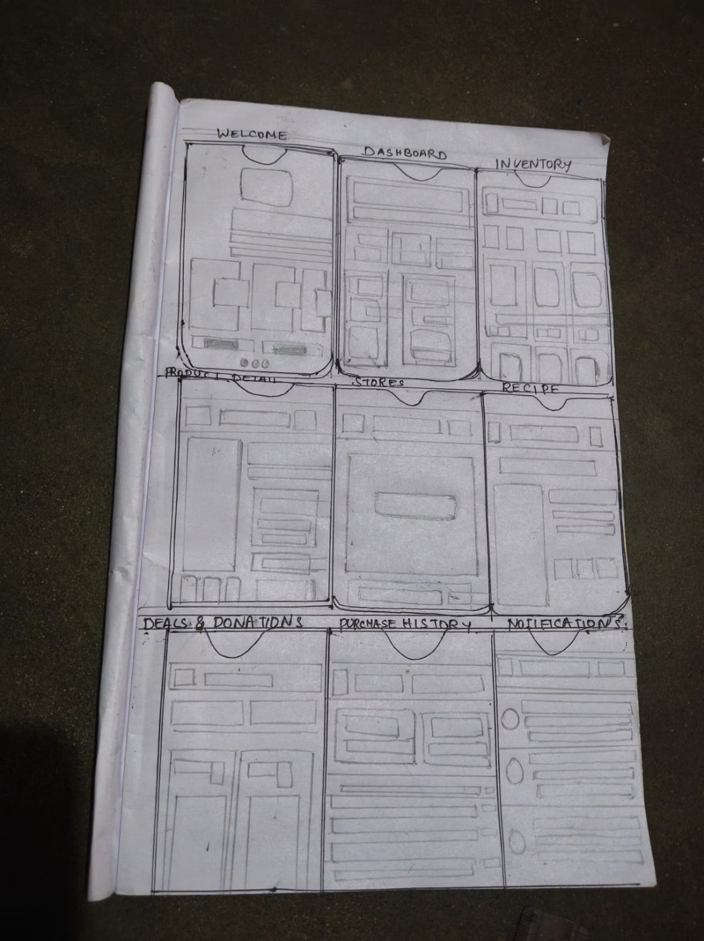
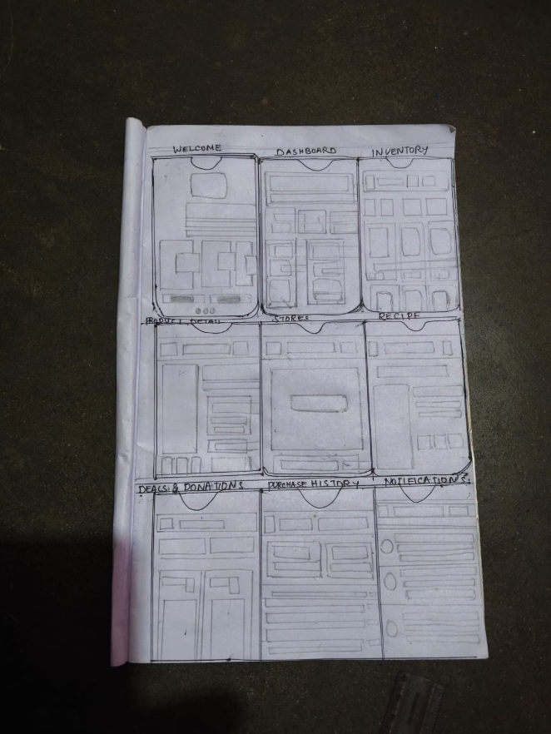
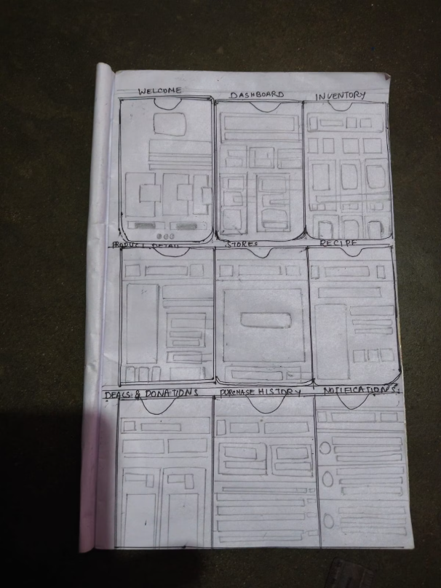
Low F
idelity:
*Basic layout for home, inventory, and shopping list screens.

Slide 15
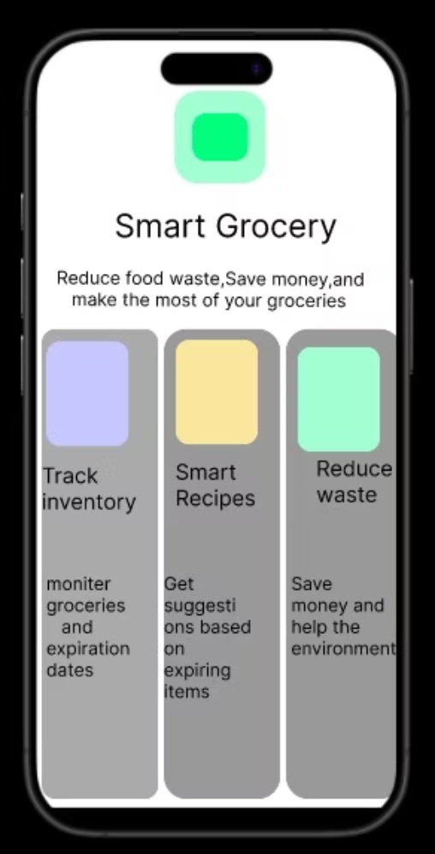
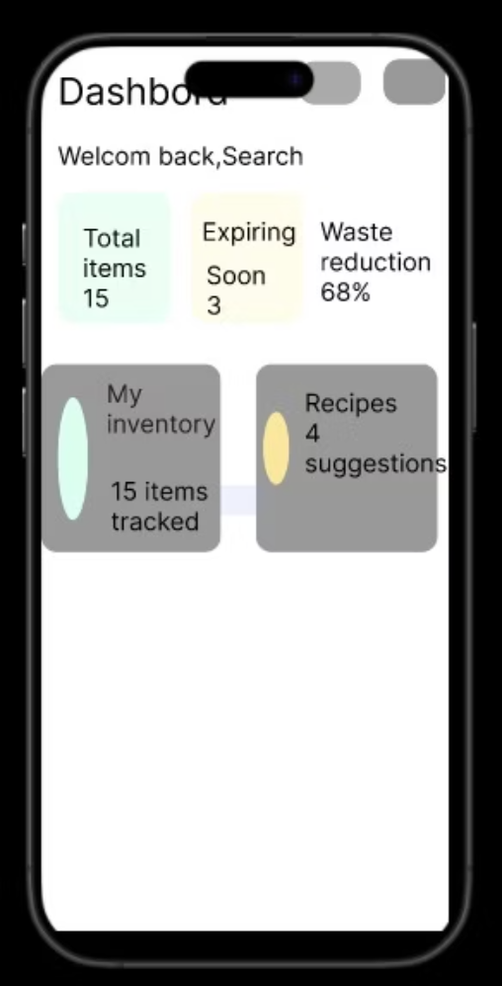
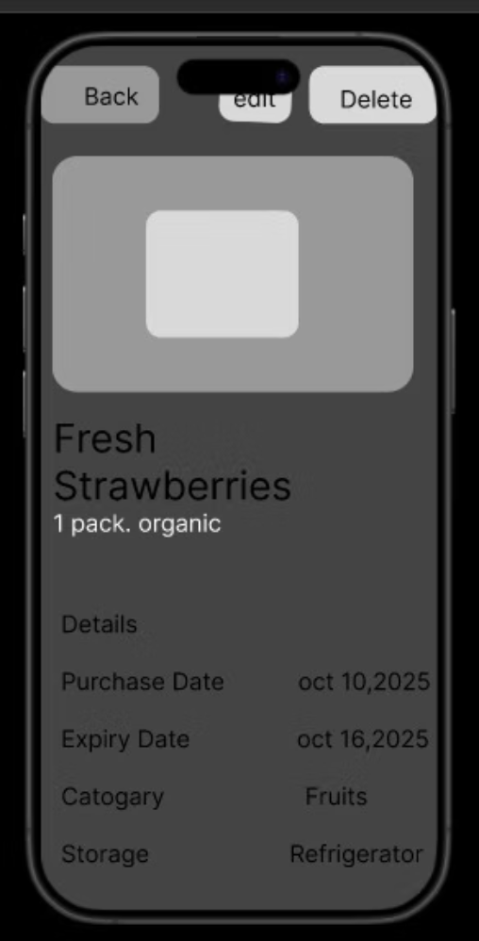
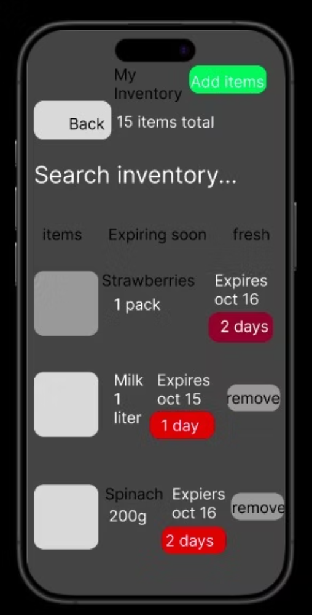
Middle Fidelity:
*Added navigation bar, expiry alert section, and item card layout.

Slide 16
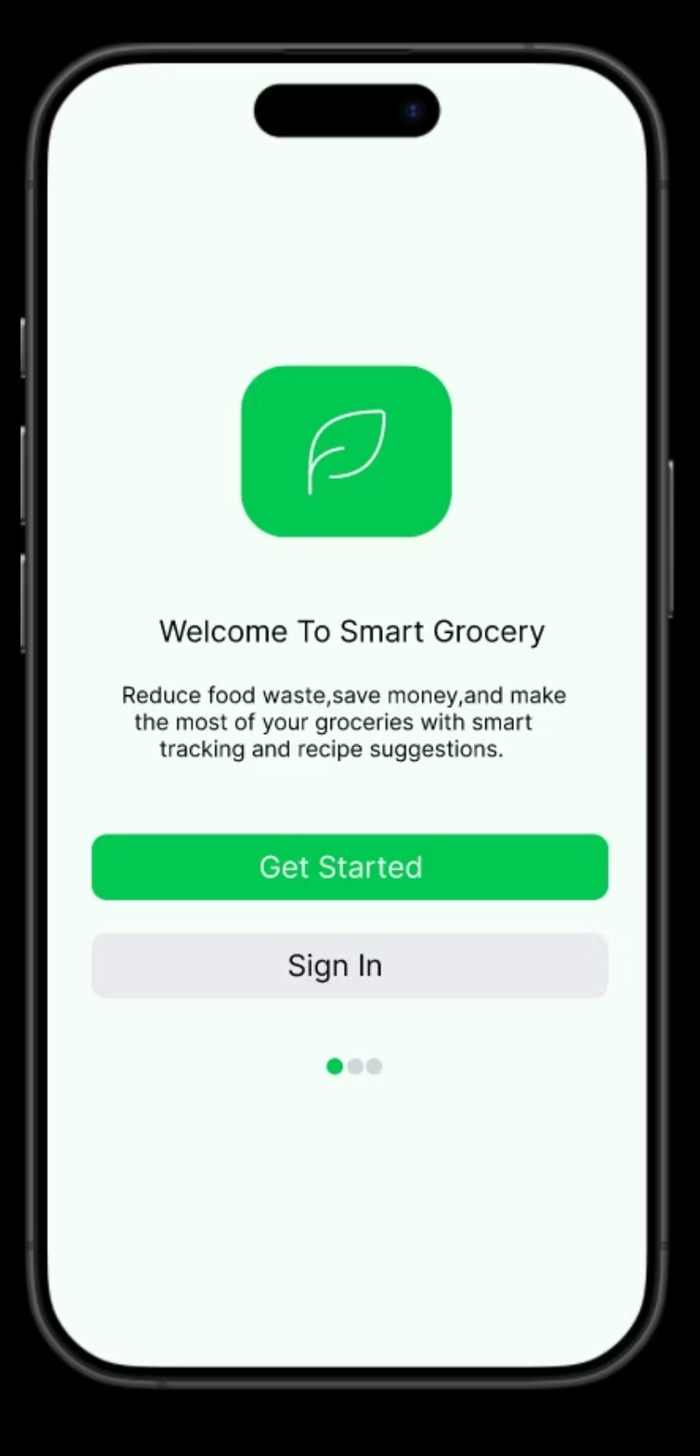
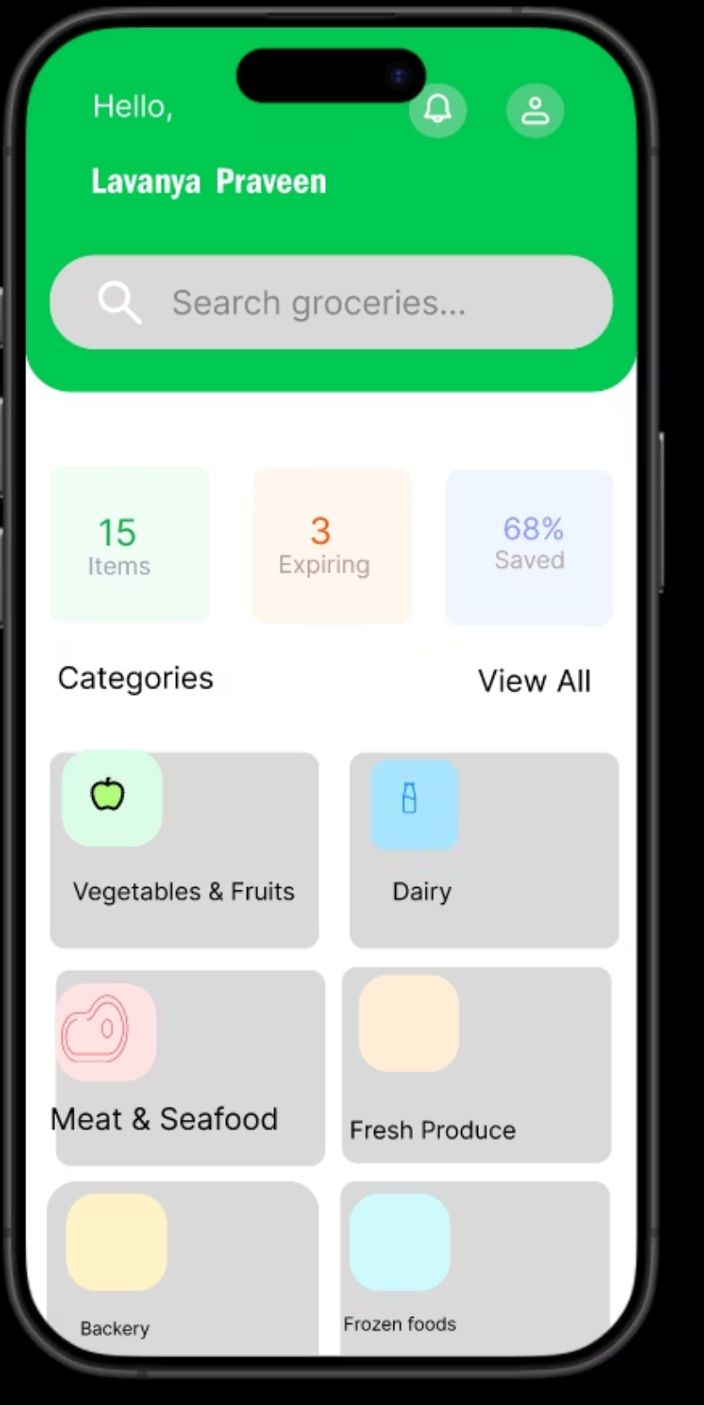
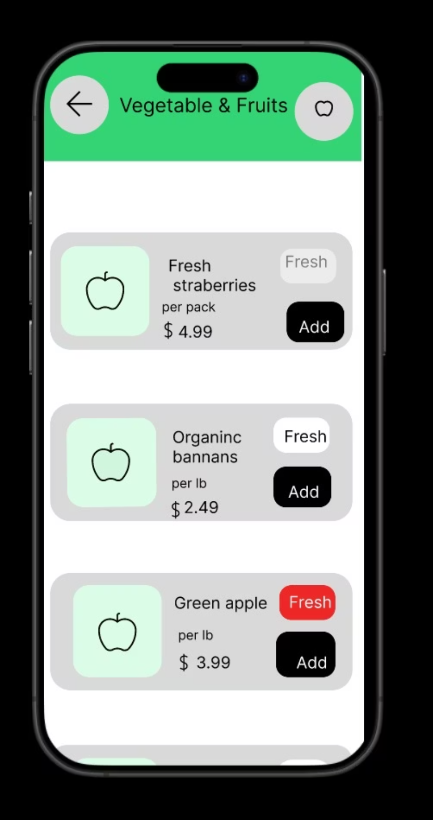
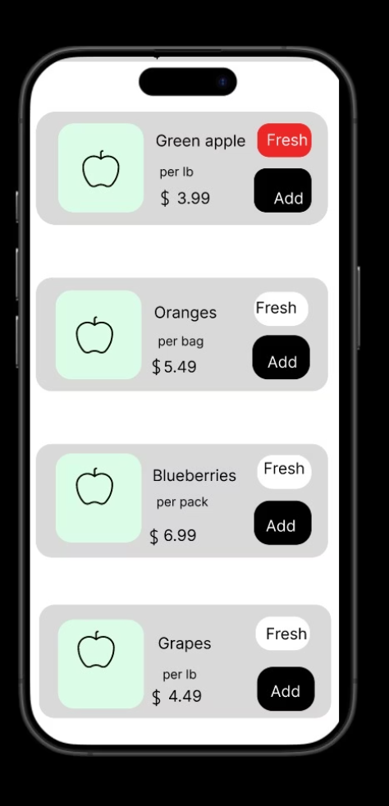
High Fidelity:

Slide 17
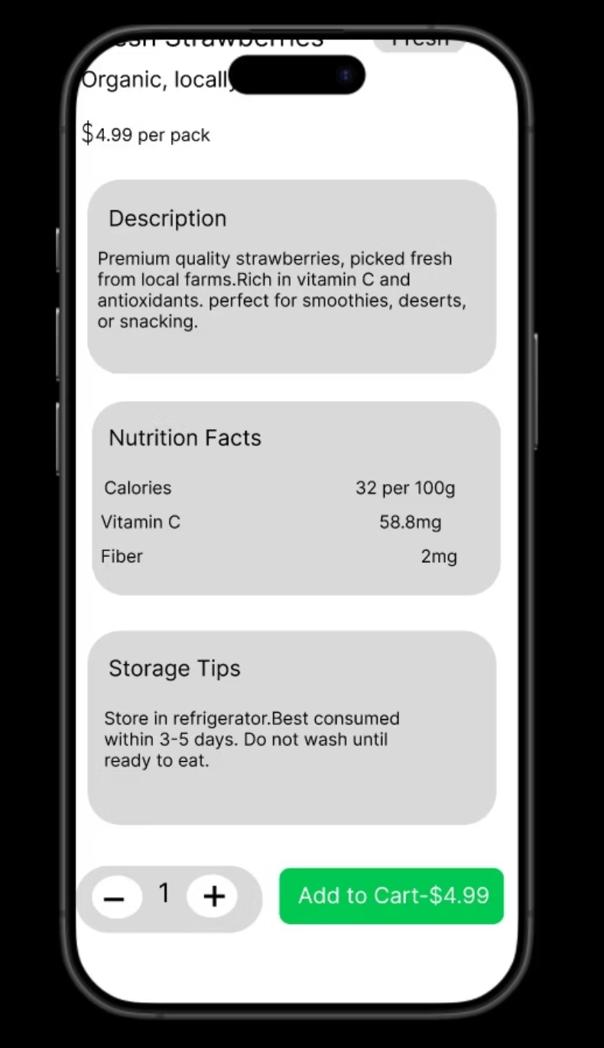
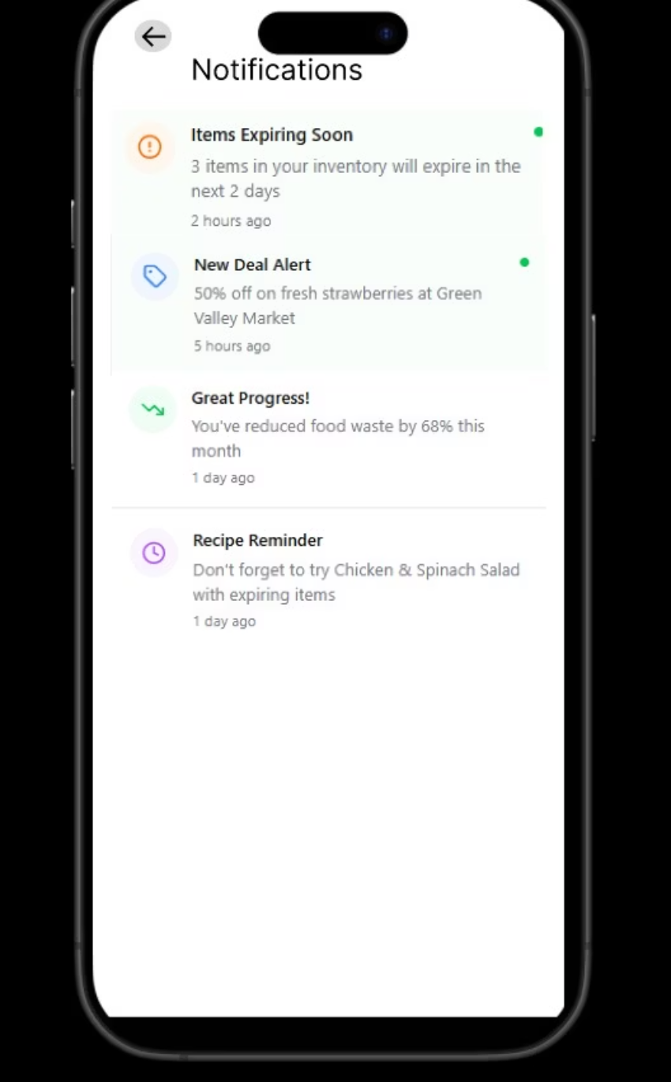
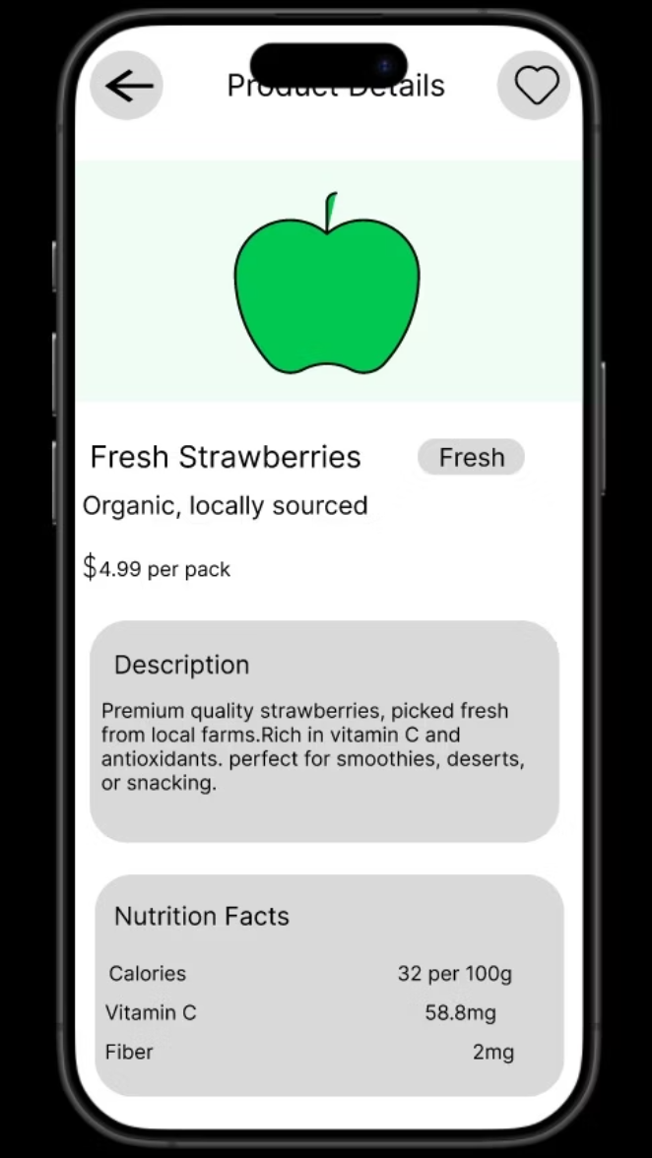

Slide 18
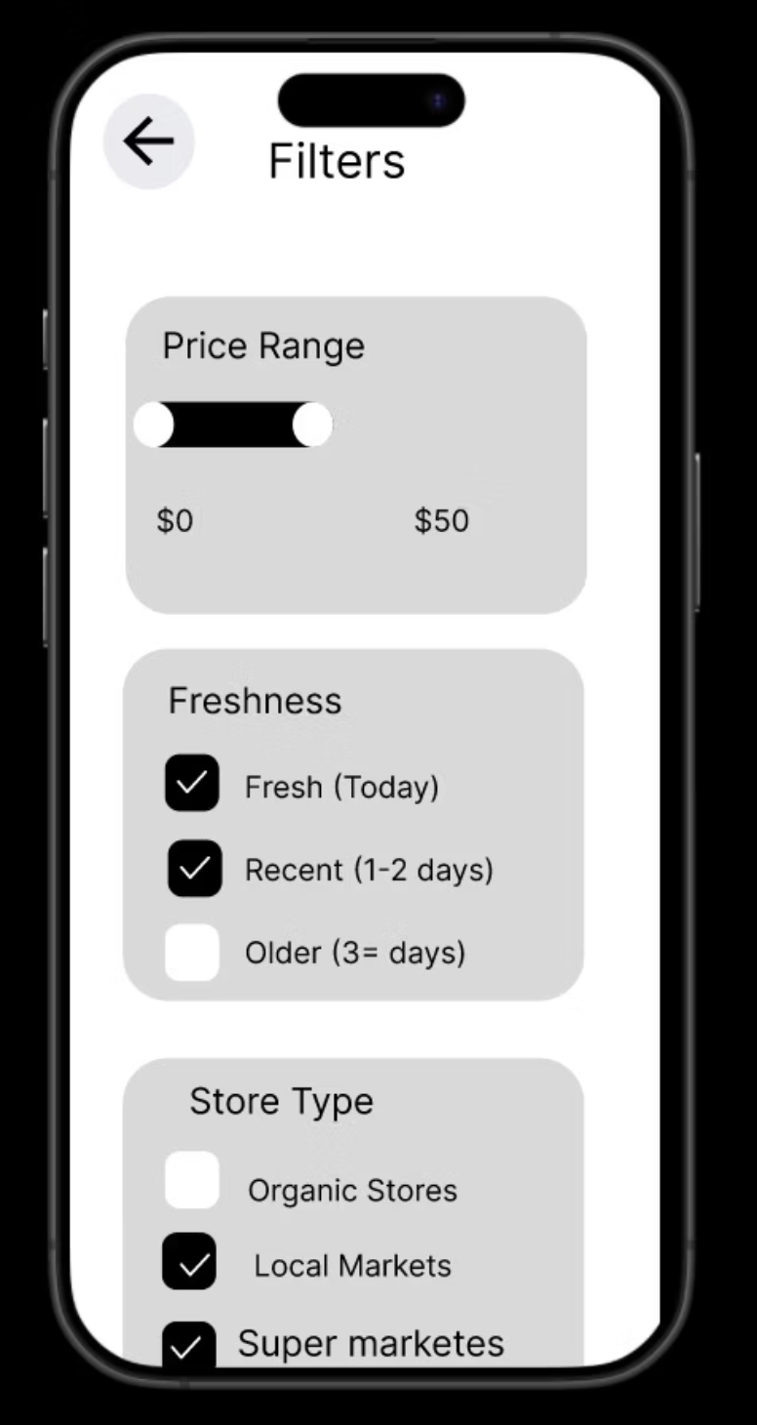
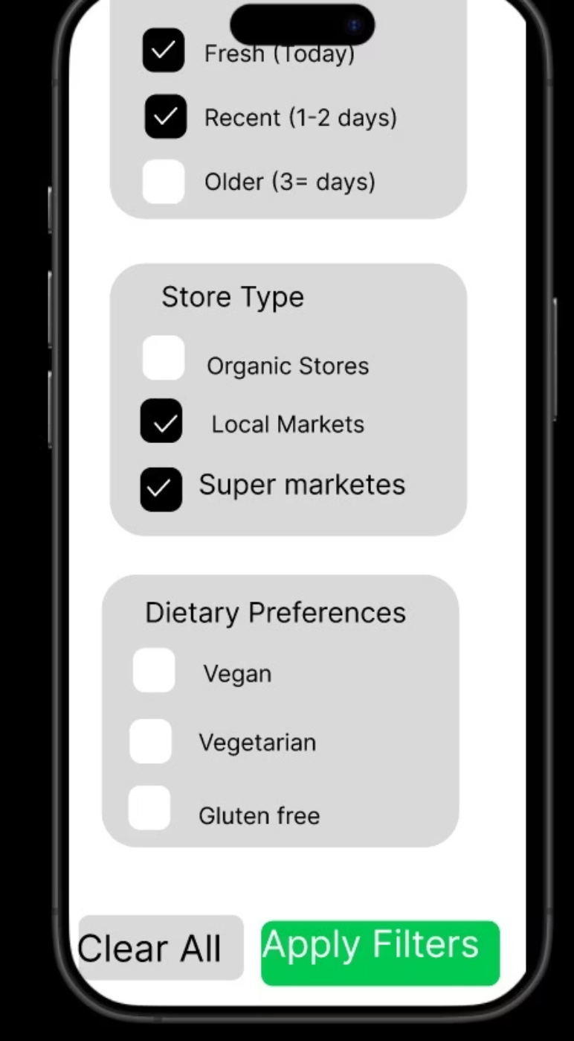

Slide 19

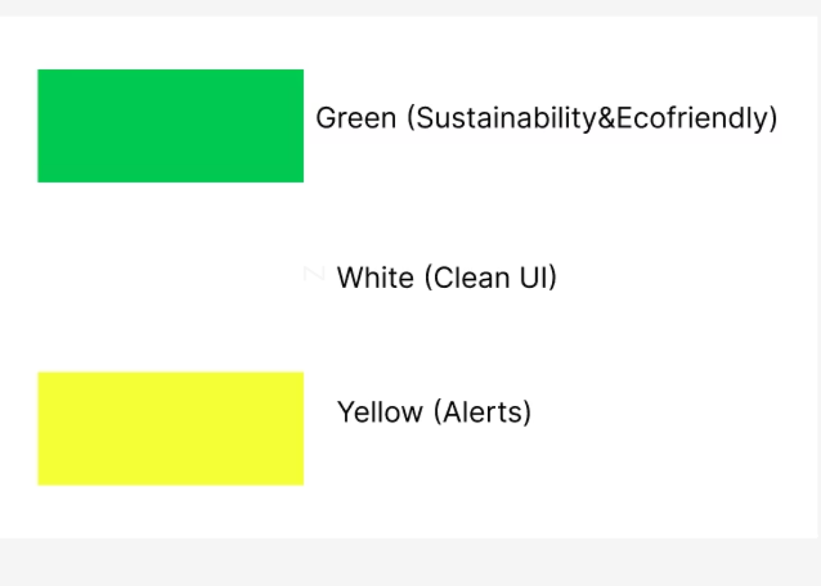
UX Case Study:
Style Guide:
1.Colors:
:Green (Sustainability)
White (Clean UI)
Yellow (Alerts)
2. Typography:
Poppins/Inter
3. Icons:
Minimal & rounded
Iteration & Improvements:
Improved color contrast for expiry warnings
Simplified navigation icons
Added "quick Add" for grocery items
Structure for Portfolio:
Cover: Smart Grocery Companion App
Tagline: "Save food , save the planet".
Sections: problem → Research → Persona → userflow → Wireframes → UI → Testing → Outcome
Tool Used: Figma / Figjam / Notation / Canva
Future Scope:
AI based meal recommendations
Integration with grocery stores for auto-list sync
Family accounts with shared inventory

